Slide 1
Artificial Intelligence (Machine Learning & Deep Learning)
{
Conditional Execution & Loops
}
...

Slide 2
Contents of Day 5
Conditional Execution & Loops
Recap & introduction | Review of Python Data Structures & Introduction to Control Flow logic.
Core Thoery | Conditional Execution including If, elif, and else statements, Nested conditionals, and Conditional (Ternary) Expressions.
Lab Practice | Practical coding tasks implementing While, for loops, and the use of enumerate.
Advance Lab | Managing flow with Break, continue, and pass statements , and building nested loops and List comprehensions.
Wrap-up & Q&A | Understanding Iterators and Iterables, final debugging tips, and setting up for Week 2.
Important: Use of AI for solving given task is now allowed. Cellphones must be put on silent.

Slide 3
Today Objective - Control Flow
Why Control Flow matters ? In AI and Machine Learning, algorithms must make decisions based on data. Control flow is the foundation of those decisions.
Imagine a self-driving car rolling down the street. How does it know what to do? It uses simple rules: IF the traffic light is red: THEN hit the brakes. ELSE IF the light is green: THEN keep going. This step-by-step decision-making is called "control flow."
}
..

Slide 4
Core Concept (Definition & Rules)
{
Definition:
Conditional Execution (If, Elif, Else)
Rules:
Statements that allow your code to execute different blocks based on whether a condition evaluates to True or False.
Why we use it:
To create logic branches. For example, if an image contains a face, run the facial recognition model; else, discard the image.
Always watch your indentation. Python relies on whitespace, not brackets. Over-nesting conditionals can make code unreadable.
Real-world AI Application: Data filtering
if data_missing == True:
apply_imputation()
}
*

Slide 5
Core Concept (Definition & Rules)
{
Definition:
Looping Mechanisms (For, While, Enumerate)
Rules:
Loops allow the repetition of a code block until a specific condition is met or an iterable is exhausted.
Why we use it:
To process large datasets. ML models require iterating over thousands of data points (epochs).
Infinite loops (usually in while loops without a proper exit condition) will crash your environment. Avoid heavy computations inside nested loops
Real-world AI Application: Training a neural network over multiple epochs: for epoch in range(100): train_model()
}
*

Slide 6
Core Concept (Definition & Rules)
{
Definition:
Loop Control (Break, Continue, Pass)
break:
Statements that alter the standard flow of a loop.
Why we use it:
To stop the loop completely or let it run with conditions
Exits the loop entirely.
continue: Skips the current iteration and moves to the next. pass:
A null operation; a placeholder for future code.
}
*

Slide 7
Core Concept (Definition & Rules)
{
Definition:
Advanced Looping – Understanding enumerate()
Why we use it:
It is the cleanest way to track where you are in a list. In Machine Learning, you use this constantly to track which batch of data is currently being processed by your neural network.
enumerate() is a built-in Python function that adds a built-in counter to an iterable (like a list). Instead of just giving you the item, it gives you both the Index (position) and the Item (value) at the same time.
Why not / Rules to follow: Never manually create a counter variable (e.g., count = 0 then count += 1 inside a for loop) if you are just trying to track the index. enumerate() is faster and reduces the chance of bugs.
}
*

Slide 8
Core Concept (Definition & Rules)
{
Definition:
Advanced Looping – Understanding List Comprehensions
A List Comprehension is a shorter, faster, one-line syntax used to create a new list based on the values of an existing list or range.
Why we use it:
It is highly optimized in Python and runs faster than a standard for loop. In AI Data Preprocessing, it is perfect for quickly transforming data. Real-World AI Example: Normalizing image pixels so they are between 0 and 1: pixels_normalized = [p / 255.0 for p in image_pixels]
Why not / Rules to follow: Do not overcomplicate them. If your list comprehension requires complex nested if/else logic that stretches across a very long line, switch back to a standard for loop. Readability is more important than writing everything on one line.
}
*

Slide 9
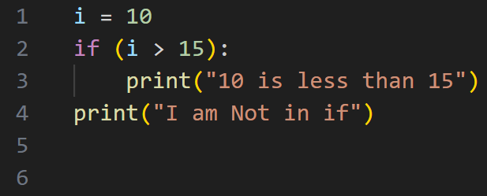
Practical exercise 01
Lab Task 1 – Simple & Nested Conditionals
*

Slide 10
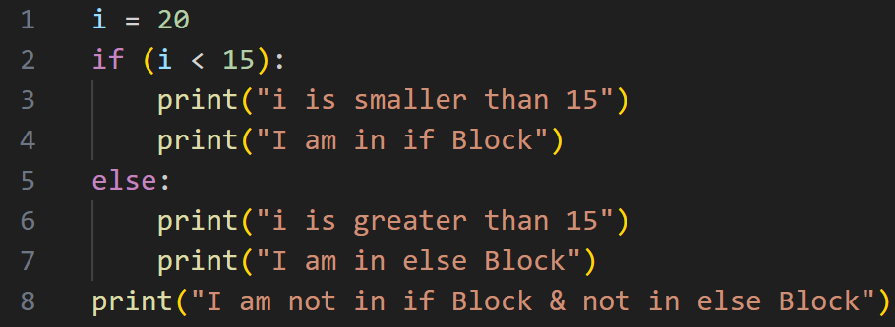
Practical exercise 02
Lab Task 2 – Simple & Nested Conditionals
*

Slide 11
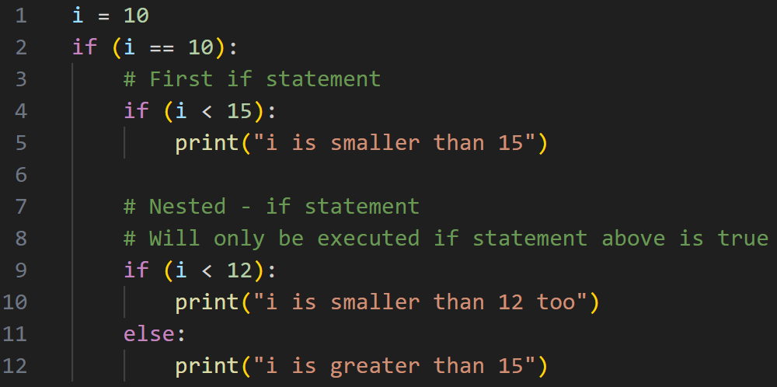
Practical exercise 03
Lab Task 3 – Nested if Conditionals
*
This demonstrates how an if statement can be placed inside another if statement to check multiple conditions.

Slide 12
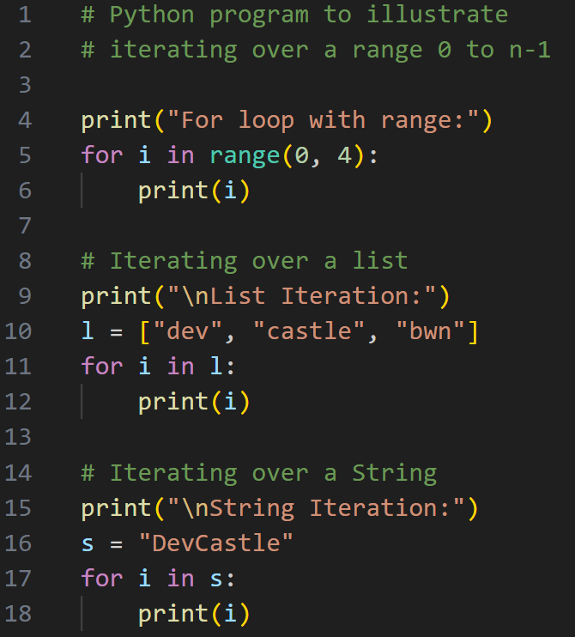
Practical exercise 04
Lab Task 4 – for Loops
demonstrates looping over a range(),
a list, and a string.
Here is their standard introductory code:
*

Slide 13
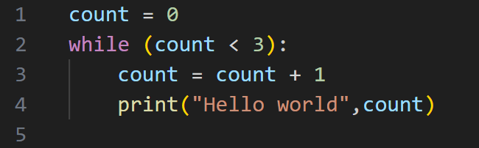
Practical exercise 05
Lab Task 5 – while Loops Here is the classic while loop example
*

Slide 14
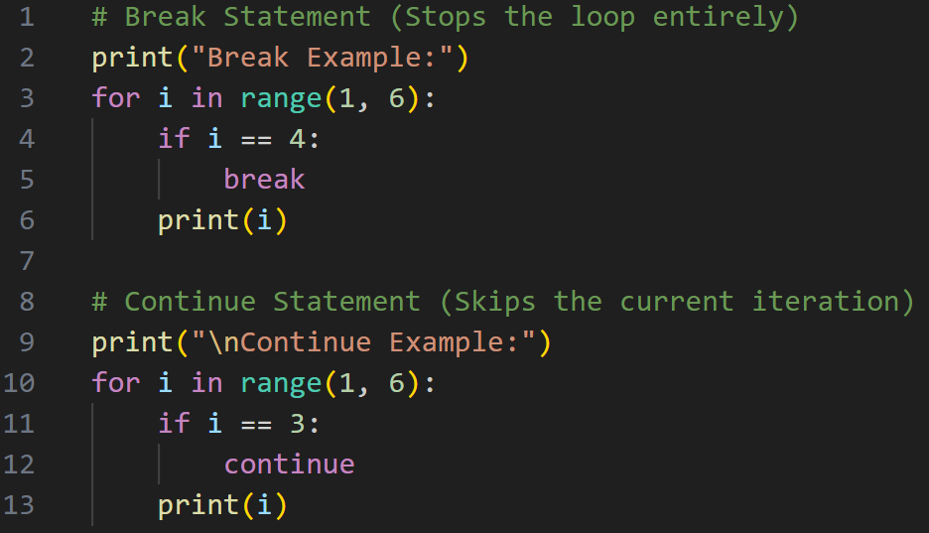
Practical exercise 06
Lab Task 6 - How to interrupt or skip iterations within a loop.
*

Slide 15
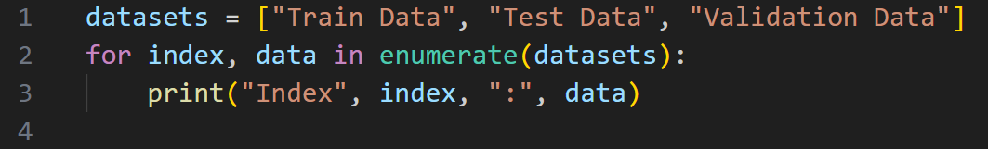
Practical exercise 07
Lab Task 7 - Advanced Looping – Understanding enumerate()
It add takes a collection (e.g. a tuple) and returns it as an enumerate object. Also adds a counter as the key of the enumerate object.
[(0, 'apple'), (1, 'banana'), (2, 'cherry')]
In the code enumerate(datasets), Python looks at "Train Data" and attaches the number 0 to it. It looks at "Test Data" and attaches 1, and so on.
*

Slide 16
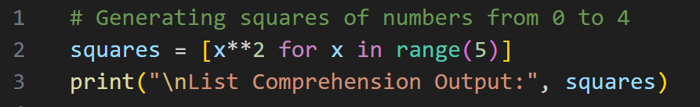
Practical exercise 08
Lab Task 8 - Advanced Looping – Understanding List Comprehensions
List comprehension offers a shorter syntax when you want to create a new list based on the values of an existing list.
newlist = [expression for item in iterable if condition == True]
It condenses a standard for loop and an action into a single line wrapped in square brackets []. In [x**2 for x in range(5)], Python reads right-to-left: first it gets a number from range(5), then it applies the math x**2 (x squared), and immediately drops the result into a new list.
*

Slide 17
Thanks!
<Do you have any questions, feel free to ask >

